Slide 1
Cryptography and Network Security Chapter 10
Fourth Edition
by William Stallings
Lecture slides by Lawrie Brown
Notes:
Lecture slides by Lawrie Brown for “Cryptography and Network Security”, 4/e, by William Stallings, Chapter 10 – “Key Management; Other Public Key Cryptosystems”.

Slide 2
Chapter 10 – Key Management; Other Public Key Cryptosystems
No Singhalese, whether man or woman, would venture out of the house without a bunch of keys in his hand, for without such a talisman he would fear that some devil might take advantage of his weak state to slip into his body.
—The Golden Bough, Sir James George Frazer
Notes:
Opening quote.

Slide 3
Key Management
public-key encryption helps address key distribution problems
have two aspects of this:
distribution of public keys
use of public-key encryption to distribute secret keys
Notes:
One of the major roles of public-key encryption has been to address the problem of key distribution, with two distinct aspects: the distribution of public keys, and the use of public-key encryption to distribute secret keys.

Slide 4
Distribution of Public Keys
can be considered as using one of:
public announcement
publicly available directory
public-key authority
public-key certificates
Notes:
Several techniques have been proposed for the distribution of public keys, which can mostly be grouped into the categories shown.

Slide 5
Public Announcement
users distribute public keys to recipients or broadcast to community at large
eg. append PGP keys to email messages or post to news groups or email list
major weakness is forgery
anyone can create a key claiming to be someone else and broadcast it
until forgery is discovered can masquerade as claimed user
Notes:
The point of public-key encryption is that the public key is public, hence any participant can send his or her public key to any other participant, or broadcast the key to the community at large. Its major weakness is forgery, anyone can create a key claiming to be someone else and broadcast it, and until the forgery is discovered they can masquerade as the claimed user.

Slide 6
Publicly Available Directory
can obtain greater security by registering keys with a public directory
directory must be trusted with properties:
contains {name,public-key} entries
participants register securely with directory
participants can replace key at any time
directory is periodically published
directory can be accessed electronically
still vulnerable to tampering or forgery
Notes:
A greater degree of security can be achieved by maintaining a publicly available dynamic directory of public keys. Maintenance and distribution of the public directory would have to be the responsibility of some trusted entity or organization. This scheme is clearly more secure than individual public announcements but still has vulnerabilities to tampering or forgery.

Slide 7
Public-Key Authority
improve security by tightening control over distribution of keys from directory
has properties of directory
and requires users to know public key for the directory
then users interact with directory to obtain any desired public key securely
does require real-time access to directory when keys are needed
Notes:
Stronger security for public-key distribution can be achieved by providing tighter control over the distribution of public keys from the directory. It requires users to know the public key for the directory, and that they interact with directory in real-time to obtain any desired public key securely. Note that a total of seven messages are required, as shown next.

Slide 8
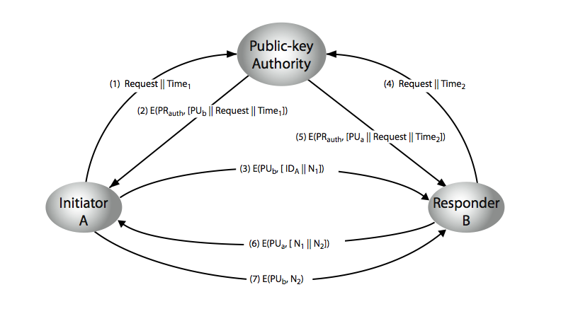
Public-Key Authority
Notes:
Stallings Figure 10.3 “Public-Key Authority” illustrates a typical protocol interaction. See text for details of steps in protocol.

Slide 9
Public-Key Certificates
certificates allow key exchange without real-time access to public-key authority
a certificate binds identity to public key
usually with other info such as period of validity, rights of use etc
with all contents signed by a trusted Public-Key or Certificate Authority (CA)
can be verified by anyone who knows the public-key authorities public-key
Notes:
An further improvement is to use certificates, which can be used to exchange keys without contacting a public-key authority, in a way that is as reliable as if the keys were obtained directly from a public-key authority. A certificate binds an identity to public key, with all contents signed by a trusted Public-Key or Certificate Authority (CA). This can be verified by anyone who knows the public-key authorities public-key.
One scheme has become universally accepted for formatting public-key certificates: the X.509 standard. X.509 certificates are used in most network security applications, including IP security, secure sockets layer (SSL), secure electronic transactions (SET), and S/MIME. Will discuss it in much more detail later.

Slide 10
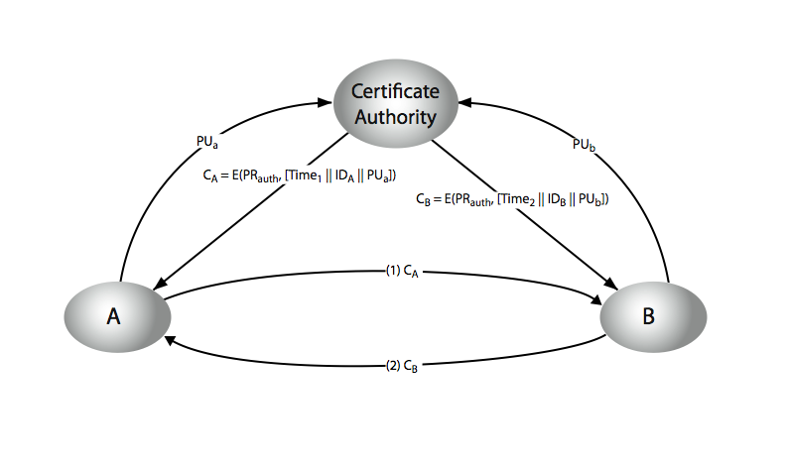
Public-Key Certificates
Notes:
Stallings Figure 10.4 “Public-Key Certificates” illustrates such a scheme. See text for details of steps in protocol.

Slide 11
Public-Key Distribution of Secret Keys
use previous methods to obtain public-key
can use for secrecy or authentication
but public-key algorithms are slow
so usually want to use private-key encryption to protect message contents
hence need a session key
have several alternatives for negotiating a suitable session
Notes:
Once public keys have been distributed or have become accessible, secure communication that thwarts eavesdropping, tampering, or both, is possible. However, few users will wish to make exclusive use of public-key encryption for communication because of the relatively slow data rates that can be achieved. Accordingly, public-key encryption provides for the distribution of secret keys to be used for conventional encryption.

Slide 12
Simple Secret Key Distribution
proposed by Merkle in 1979
A generates a new temporary public key pair
A sends B the public key and their identity
B generates a session key K sends it to A encrypted using the supplied public key
A decrypts the session key and both use
problem is that an opponent can intercept and impersonate both halves of protocol
Notes:
An extremely simple scheme was put forward by Merkle [MERK79]. But it is insecure against an adversary who can intercept messages and then either relay the intercepted message or substitute another message. Such an attack is known as a man-in-the-middle attack [RIVE84].

Slide 13
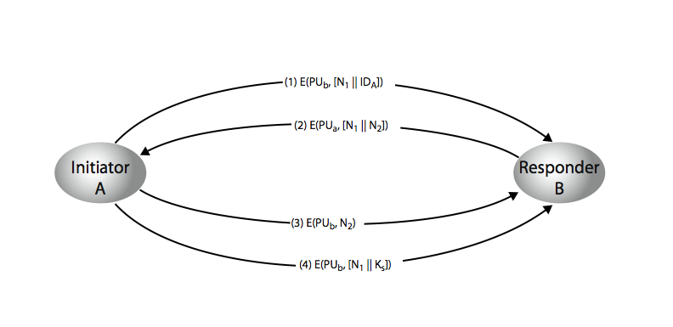
Public-Key Distribution of Secret Keys
if have securely exchanged public-keys:
Notes:
Stallings Figure 10.6 “Public-Key Distribution of Secret Keys” illustrates such an exchange. See text for details of steps in protocol. Note that these steps correspond to final 3 of Figure 10.3, hence can get both secret key exchange and authentication in a single protocol.

Slide 14
Hybrid Key Distribution
retain use of private-key KDC
shares secret master key with each user
distributes session key using master key
public-key used to distribute master keys
especially useful with widely distributed users
rationale
performance
backward compatibility
Notes:
Yet another way to use public-key encryption to distribute secret keys is a hybrid approach in use on IBM mainframes [LE93]. This scheme retains the use of a key distribution center (KDC) that shares a secret master key with each user and distributes secret session keys encrypted with the master key. A public key scheme is used to distribute the master keys. The addition of a public-key layer provides a secure, efficient means of distributing master keys. This is an advantage in a configuration in which a single KDC serves a widely distributed set of users.

Slide 15
Diffie-Hellman Key Exchange
first public-key type scheme proposed
by Diffie & Hellman in 1976 along with the exposition of public key concepts
note: now know that Williamson (UK CESG) secretly proposed the concept in 1970
is a practical method for public exchange of a secret key
used in a number of commercial products
Notes:
The idea of public key schemes, and the first practical scheme, which was for key distribution only, was published in 1977 by Diffie & Hellman. The concept had been previously described in a classified report in 1970 by Williamson (UK CESG) - and subsequently declassified in 1987, see [ELLI99].

Slide 16
Diffie-Hellman Key Exchange
a public-key distribution scheme
cannot be used to exchange an arbitrary message
rather it can establish a common key
known only to the two participants
value of key depends on the participants (and their private and public key information)
based on exponentiation in a finite (Galois) field (modulo a prime or a polynomial) - easy
security relies on the difficulty of computing discrete logarithms (similar to factoring) – hard
Notes:
The purpose of the algorithm is to enable two users to securely exchange a key that can then be used for subsequent encryption of messages. The algorithm itself is limited to the exchange of secret values, which depends on the value of the public/private keys of the participants. The Diffie-Hellman algorithm uses exponentiation in a finite (Galois) field (modulo a prime or a polynomial), and depends for its effectiveness on the difficulty of computing discrete logarithms.

Slide 17
Diffie-Hellman Setup
all users agree on global parameters:
large prime integer or polynomial q
a being a primitive root mod q
each user (eg. A) generates their key
chooses a secret key (number): x_{A} < q
compute their public key: y_{A} = a^{xA} mod q
each user makes public that key y_{A}
Notes:
In the Diffie-Hellman key exchange algorithm, there are two publicly known numbers: a prime number q and an integer a that is a primitive root of q. The prime q and primitive root a can be common to all using some instance of the D-H scheme. Note that the primitive root a is a number whose powers successively generate all the elements mod q. Users Alice and Bob choose random secrets x's, and then "protect" them using exponentiation to create their public y's. For an attacker monitoring the exchange of the y's to recover either of the x's, they'd need to solve the discrete logarithm problem, which is hard.

Slide 18
Diffie-Hellman Key Exchange
shared session key for users A & B is K_{AB}:
K_{AB} = a^{xA.xB} mod q
= y_{A}^{xB} mod q (which B can compute)
= y_{B}^{xA} mod q (which A can compute)
K_{AB} is used as session key in private-key encryption scheme between Alice and Bob
if Alice and Bob subsequently communicate, they will have the same key as before, unless they choose new public-keys
attacker needs an x, must solve discrete log
Notes:
The actual key exchange for either party consists of raising the others "public key' to power of their private key. The resulting number (or as much of as is necessary) is used as the key for a block cipher or other private key scheme. For an attacker to obtain the same value they need at least one of the secret numbers, which means solving a discrete log, which is computationally infeasible given large enough numbers. Note that if Alice and Bob subsequently communicate, they will have the same key as before, unless they choose new public-keys.

Slide 19
Diffie-Hellman Example
users Alice & Bob who wish to swap keys:
agree on prime q=353 and a=3
select random secret keys:
A chooses x_{A}=97, B chooses x_{B}=233
compute respective public keys:
y_{A}=3⁹⁷ mod 353 = 40 (Alice)
y_{B}=3²³³ mod 353 = 248 (Bob)
compute shared session key as:
K_{AB}= y_{B}^{xA} mod 353 = 248⁹⁷ = 160 (Alice)
K_{AB}= y_{A}^{xB} mod 353 = 40²³³ = 160 (Bob)
Notes:
Here is an example of Diffie-Hellman from the text.

Slide 20
Key Exchange Protocols
users could create random private/public D-H keys each time they communicate
users could create a known private/public D-H key and publish in a directory, then consulted and used to securely communicate with them
both of these are vulnerable to a meet-in-the-Middle Attack
authentication of the keys is needed
Notes:
Detail a couple of possible Key Exchange Protocols based on Diffie-Hellman. Note that these are vulnerable to a meet-in-the-Middle Attack, and that authentication of the keys is needed.

Slide 21
Elliptic Curve Cryptography
majority of public-key crypto (RSA, D-H) use either integer or polynomial arithmetic with very large numbers/polynomials
imposes a significant load in storing and processing keys and messages
an alternative is to use elliptic curves
offers same security with smaller bit sizes
newer, but not as well analysed
Notes:
A major issue with the use of Public-Key Cryptography, is the size of numbers used, and hence keys being stored. Recently, an alternate approach has emerged, elliptic curve cryptography (ECC), which performs the computations using elliptic curve arithmetic instead of integer or polynomial arithmetic. Already, ECC is showing up in standardization efforts, including the IEEE P1363 Standard for Public-Key Cryptography. Although the theory of ECC has been around for some time, it is only recently that products have begun to appear and that there has been sustained cryptanalytic interest in probing for weaknesses. Accordingly, the confidence level in ECC is not yet as high as that in RSA.

Slide 22
Real Elliptic Curves
an elliptic curve is defined by an equation in two variables x & y, with coefficients
consider a cubic elliptic curve of form
y² = x³ + ax + b
where x,y,a,b are all real numbers
also define zero point O
have addition operation for elliptic curve
geometrically sum of Q+R is reflection of intersection R
Notes:
First consider elliptic curves using real number values. See text for detailed rules of addition and relation to zero point O. Can derive an algebraic interpretation of addition, based on computing gradient of tangent and then solving for intersection with curve. There is also an algebraic description of additions over elliptic curves, see text.

Slide 23
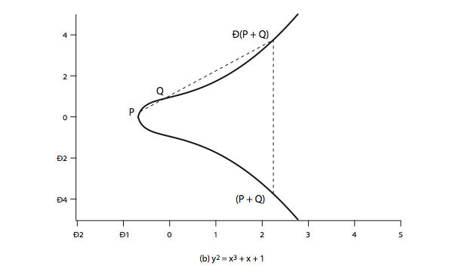
Real Elliptic Curve Example
Notes:
Stallings Figure 10.9b “Example of Elliptic Curves”, illustrates the geometric interpretation of elliptic curve addition.

Slide 24
Finite Elliptic Curves
Elliptic curve cryptography uses curves whose variables & coefficients are finite
have two families commonly used:
prime curves E_{p}(a,b) defined over Z_{p}
use integers modulo a prime
best in software
binary curves E_{2m}(a,b) defined over GF(2^{n})
use polynomials with binary coefficients
best in hardware
Notes:
Elliptic curve cryptography makes use of elliptic curves in which the variables and coefficients are all restricted to elements of a finite field. Two families of elliptic curves are used in cryptographic applications: prime curves over Z_{p} (best for software use), and binary curves over GF(2^{m}) (best for hardware use).
There is no obvious geometric interpretation of elliptic curve arithmetic over finite fields. The algebraic interpretation used for elliptic curve arithmetic over does readily carry over. See text for detailed discussion.

Slide 25
Elliptic Curve Cryptography
ECC addition is analog of modulo multiply
ECC repeated addition is analog of modulo exponentiation
need “hard” problem equiv to discrete log
Q=kP, where Q,P belong to a prime curve
is “easy” to compute Q given k,P
but “hard” to find k given Q,P
known as the elliptic curve logarithm problem
Certicom example: E₂₃(9,17)
Notes:
Elliptic Curve Cryptography uses addition as an analog of modulo multiply, and repeated addition as an analog of modulo exponentiation. The “hard” problem is the elliptic curve logarithm problem.

Slide 26
ECC Diffie-Hellman
can do key exchange analogous to D-H
users select a suitable curve E_{p}(a,b)
select base point G=(x₁,y₁)
with large order n s.t. nG=O
A & B select private keys n_{A}<n, n_{B}<n
compute public keys: P_{A}=n_{A}G, P_{B}=n_{B}G
compute shared key: K=n_{A}P_{B}, K=n_{B}P_{A}
same since K=n_{A}n_{B}G
Notes:
Illustrate here the elliptic curve analog of Diffie-Hellman key exchange, which is a close analogy given elliptic curve multiplication equates to modulo exponentiation.

Slide 27
ECC Encryption/Decryption
several alternatives, will consider simplest
must first encode any message M as a point on the elliptic curve P_{m}
select suitable curve & point G as in D-H
each user chooses private key n_{A}<n
and computes public key P_{A}=n_{A}G
to encrypt P_{m} : C_{m}={kG, P_{m}+kP_{b}}, k random
decrypt C_{m} compute:
P_{m}+kP_{b}–n_{B}(kG) = P_{m}+k(n_{B}G)–n_{B}(kG) = P_{m}
Notes:
Several approaches to encryption/decryption using elliptic curves have been analyzed in the literature. This one is an analog of the ElGamal public-key encryption algorithm. The sender must first encode any message M as a point on the elliptic curve P_{m} (there are relatively straightforward techniques for this). Note that the ciphertext is a pair of points on the elliptic curve. The sender masks the message using random k, but also sends along a “clue” allowing the receiver who know the private-key to recover k and hence the message. For an attacker to recover the message, the attacker would have to compute k given G and kG, which is assumed hard.

Slide 28
ECC Security
relies on elliptic curve logarithm problem
fastest method is “Pollard rho method”
compared to factoring, can use much smaller key sizes than with RSA etc
for equivalent key lengths computations are roughly equivalent
hence for similar security ECC offers significant computational advantages
Notes:
The security of ECC depends on how difficult it is to determine k given kP and P. This is referred to as the elliptic curve logarithm problem. The fastest known technique for taking the elliptic curve logarithm is known as the Pollard rho method. Compared to factoring integers or polynomials, can use much smaller numbers for equivalent levels of security.

Slide 29
Comparable Key Sizes for Equivalent Security
Symmetric scheme (key size in bits) | ECC-based scheme (size of n in bits) | RSA/DSA (modulus size in bits)
56 | 112 | 512
80 | 160 | 1024
112 | 224 | 2048
128 | 256 | 3072
192 | 384 | 7680
256 | 512 | 15360
Notes:
Stallings Table 10.3 - “ Comparable Key Sizes in Terms of Computational Effort for Cryptanalysis” illustrates the relative key sizes needed for security.

Slide 30
Summary
have considered:
distribution of public keys
public-key distribution of secret keys
Diffie-Hellman key exchange
Elliptic Curve cryptography
Notes:
Chapter 10 summary.

